Slide 1

Multi-Level Security (MLS) API
“Connected Operations (COPS) Platform”
Team 32
Jonathan Balliet, Caleb Boswell, Daniel Mills (Presenter), Jeen Shaji, Spencer Yoder
Notes:
Introduce name of project and list names - 10 seconds

Slide 2
Introduction to Presentation
Skyward Federal and COPS Platform
Project structure, requirements, design, testing
Challenges
Moving forward
Notes:
Go over the main sections of the presentation - 10 seconds

Slide 3
Sponsor Background
Skyward Federal is a startup Cyber-Logistics Company
~10 employees
Custom software for government clients
Located in Washington DC
Services:
Infrastructure
Cloud Migration
Data Security
Security Operations
App Development
Notes:
20 seconds
Startup company in DC with around 10 employees, dealing with cyber logistics
Primarily develop software for government related clients
Some of the services they provide are...

Slide 4
Problem & Proposed Solution
Organizations physically separate data by security levels
Government
Banks
Decentralized data store
Inefficient
Multiple points of failure
Solution
Centralized data store
Data access restricted by labels
Multiple points of failure
Low security data
High security data
Time cost for switching
Notes:
20 seconds
The problem - organizations want to separate data based on users’ security levels
Using a decentralized data store is inefficient and has many possible points of failure
The solution - use a centralized data store. Label data and users to keep sensitive data restricted

Slide 5
Project Goals & Benefits
Virtualized system
Goals
Centralize access-based data separation in a single system
Virtualize system - services not tied to availability of a single computer
Simple REST API provides access to these services
Benefits
Reduces overhead when acquiring data from multiple sources
Reduces system complexity
Virtualization
Unique system access behind simple API calls
Removes failure related to a single computer system
DB1
DB2
Centralized DB
Notes:
20 seconds
The goals of the project are to centralize access-based data into a single system
The system will be virtualized, so that services don’t rely on a single computer being available
Implement a REST API to use these services
The benefits are that this project overcomes the problems I just talked about.
Reduces overhead and complexity
Virtualization removes one of the failure points

Slide 6
Requirements - Overall System
Functional
Store and label data from arbitrary number of sources
Authenticate user at every step
Isolate running services
Ensure user can only access data they are authorized to
Log all transactions
Non-functional
Prioritize security over performance
Installation works on an offline environment
Notes:
40 seconds
Arbitrary number of sources
Users are authenticated at every step of the process
Services are isolated - so if a user is authenticated for one service, they need to reauthenticate if they try to use another
System makes sure users only have access to authorized data
All transactions are logged
Prioritize security over performance
System should work in an offline environment

Slide 7
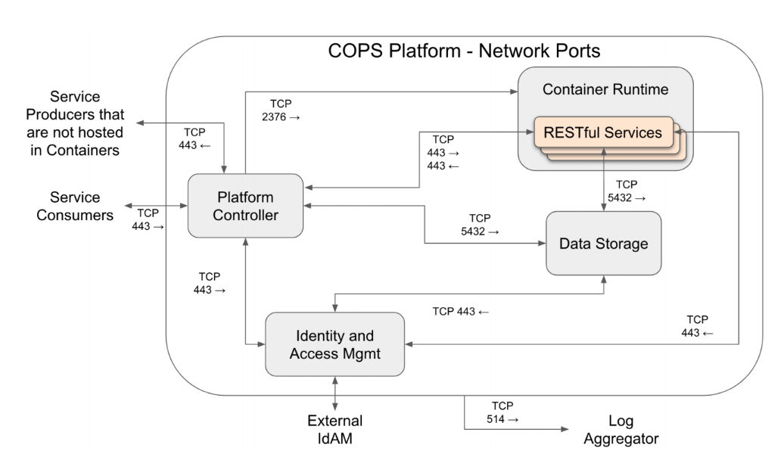
Project Structure
Four components
Container runtime
Data storage
IdAM
Platform controller
Notes:
The project as given to us was divided into four components - 10 seconds

Slide 8
Project Structure
Four components
Container runtime
Data storage
IdAM
Platform controller
Notes:
We’re focusing on these 2 components, the others are stretch goals - 10 seconds

Slide 9
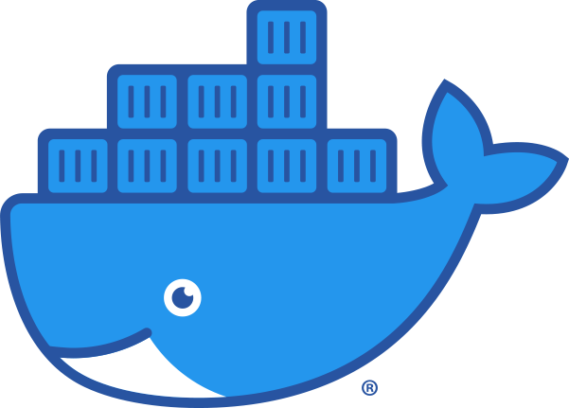
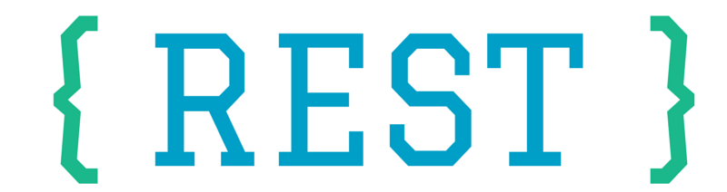
Requirements - Container Runtime
● Provide computing resources for RESTful services
● Container isolation - handle a specific user and service
● Authorized user can only access the container
● Service must gracefully handle ‘Access Denied’ errors
● Containers cannot share information with others
Notes:
30 seconds
Containers provide REST services
Users only have direct access to the container, not the data
Containers

Slide 10
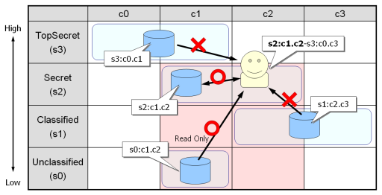
Requirements - Data Storage
Container services act as users
Each service has an account in database
Services label data with security levels and categories
Data accessible depending on their SELinux security context
Label + category
Notes:
User has security level/categories - 30 seconds

Slide 11
Requirements - Data Storage
Container services act as users
Each service has an account in database
Services label data with security levels and categories
Data accessible depending on their SELinux security context
Label + category
Notes:
Users can’t access higher levels - 10 seconds

Slide 12
Requirements - Data Storage
Container services act as users
Each service has an account in database
Services label data with security levels and categories
Data accessible depending on their SELinux security context
Label + category
Notes:
Users can access the same level/categories - 10 seconds

Slide 13
Requirements - Data Storage
Container services act as users
Each service has an account in database
Services label data with security levels and categories
Data accessible depending on their SELinux security context
Label + category
Notes:
Users have read-only access to lower levels - 10 seconds

Slide 14
Requirements - Data Storage
Container services act as users
Each service has an account in database
Services label data with security levels and categories
Data accessible depending on their SELinux security context
Label + category
Notes:
Users can’t access outside their categories - 10 seconds

Slide 15




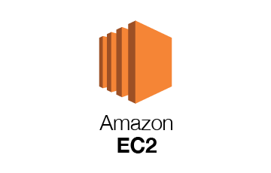

Admin
Stores and labels data
Container Runtime
Service Request
Data Storage
Container
instance running RESTful
service
SE Linux labeled data
REST
Consumer
Logs from all components
Log Aggregator
Notes:
30 seconds
On first installation, admin performs a mass labeling/storing of all data the organization already has
Then, the users within the organization talk to docker to run an instance of a service with correct security context.
Consumer then specifies REST requests to read data, write data, and get reports
The RESTful service then talks to Postgres, which carries out the given request if authorized
Meanwhile, all transactions are sent to a log aggregator

Slide 16
Sequence Diagram
Consumer
Container
Runtime
Service
Data Storage
Service Request w/ SE Linux labels
Create isolated container instance
Start service on container
Establish service connection
REST request
Process request
REST response
Authorized data
Notes:
20 seconds
REST requests and response continue until the consumer disconnects.
The service is stopped and container shutdown.

Slide 17
Testing
B
A
C
System
Tested by automating REST API calls
Security
Every combination of access controls must be tested
3 users, unique security context
Unit
Less extensive than system testing
Testing tools TBD
A
Data item 1
Data item 2
Data item 3
…
Data item n
A&B
Data item 1
Data item 2
Data item 3
…
Data item n
B
Data item 1
Data item 2
Data item 3
…
Data item n
C
Data item 1
Data item 2
Data item 3
…
Data item n
Notes:
30 seconds
We will perform system testing by automating REST API calls
We will test for security by testing every combination of access controls for 3 hypothetical users
Each user will have a unique security context. Ensure they have access to only what they are supposed to
Unit testing will be done on each individual component
Tool is TBD - first step in implementation is to pick a language

Slide 18


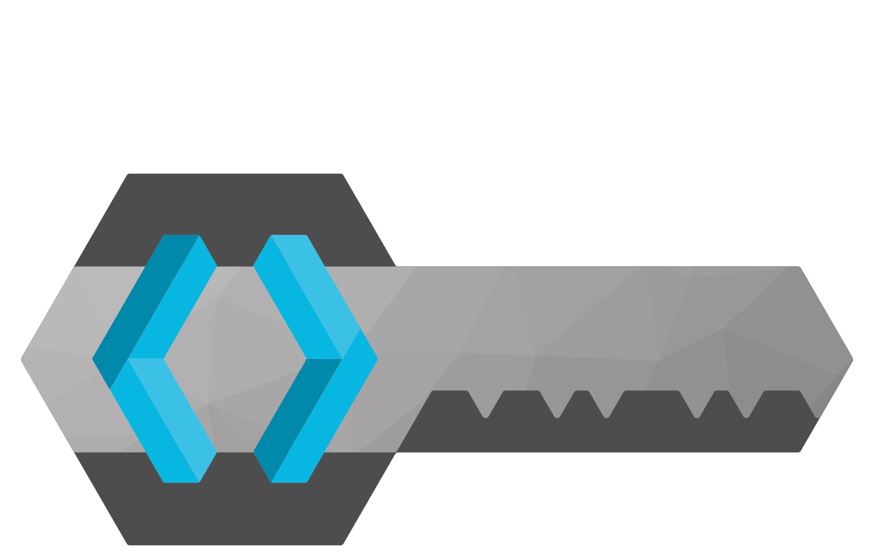
Challenges
New technologies
Lots of research
Lots of technical documentation
Changing requirements and constraints
Unknown scope
Notes:
20 seconds
We’ve had to learn a lot of new technologies, do a lot of research, and read a lot of documentation from Skyward
Another challenge is that Skyward is equally figuring out this project just as we are The requirements, constraints, and scope of the project have been constantly changing form the start

Slide 19
Member Contribution
Research Phase
Firecracker - Caleb
PostgreSQL - Daniel
Zuul - Jeen
Docker - Jonathan
SELinux - Spencer
Requirements and Design Phase
Container Runtime Team - Caleb, Jeen, Jonathan
Data Storage Team - Daniel, Spencer
Notes:
5 seconds
Each researched a different component

Slide 20
Member Contribution
Research Phase
Firecracker - Caleb
PostgreSQL - Daniel
Zuul - Jeen
Docker - Jonathan
SELinux - Spencer
Requirements and Design Phase
Container Runtime Team - Caleb, Jeen, Jonathan
Data Storage Team - Daniel, Spencer
Notes:
10 seconds
Each researched a different component
Firecracker and Zuul ended up outside of project scope (remember those challenges)
After scope settled, divided into 2 teams

Slide 21



Resources Needed
Access to Confluence and Jira
Functioning SE-Postgres database
Bastion development environment
Notes:
10 seconds
Confluence and JIRA to help us with research
Functioning SE-Postgres database to get a sense of direction
Bastion development environment to begin implementation

Slide 22
Action Items / Conclusion
Get new technologies to work
Refine requirements and design
Begin first iteration
Notes:
10 seconds
Moving forward, our tasks are to get the new technologies to actually work
Refine our requirements and design based on feedback from Skyward
Begin our first implementation

